Slide 1

Customer Churn Prediction
Devika Dileep
John Hanok
Sandra Sajimon

Slide 2
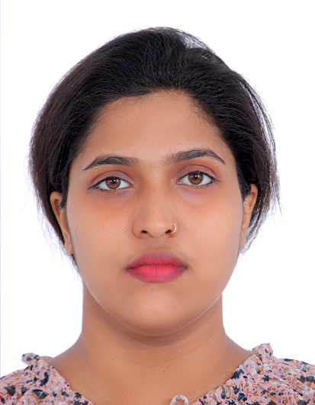


Meet our team
Devika Dileep
John Hanok
Sandra Sajimon
200566996
200573253
200567825

Slide 3
Introduction
Problem Statement: Telecom companies face significant revenue loss due to customer churn. Predicting churn can help in taking proactive measures to retain customers.
Goals: Develop a machine learning model to predict customer churn and identify key factors influencing churn.

Slide 4

Project Proposal
Scope: Analyze telecom customer data to predict churn.
Objectives:
Collect and preprocess data.
Perform exploratory data analysis (EDA).
Build and evaluate machine learning models.
Deploy the best model for real-time predictions.

Slide 5

Data Collection and Preparation

Slide 6
Dataset Source: The dataset was sourced from YBIFoundation. Data Cleaning: Handled missing values using forward fill. Removed duplicate records. Converted 'TotalCharges' to numeric and handled errors. Data Preprocessing: One-hot encoded categorical variables. Standardized 'MonthlyCharges' and 'TotalCharges' using StandardScaler.

Slide 7
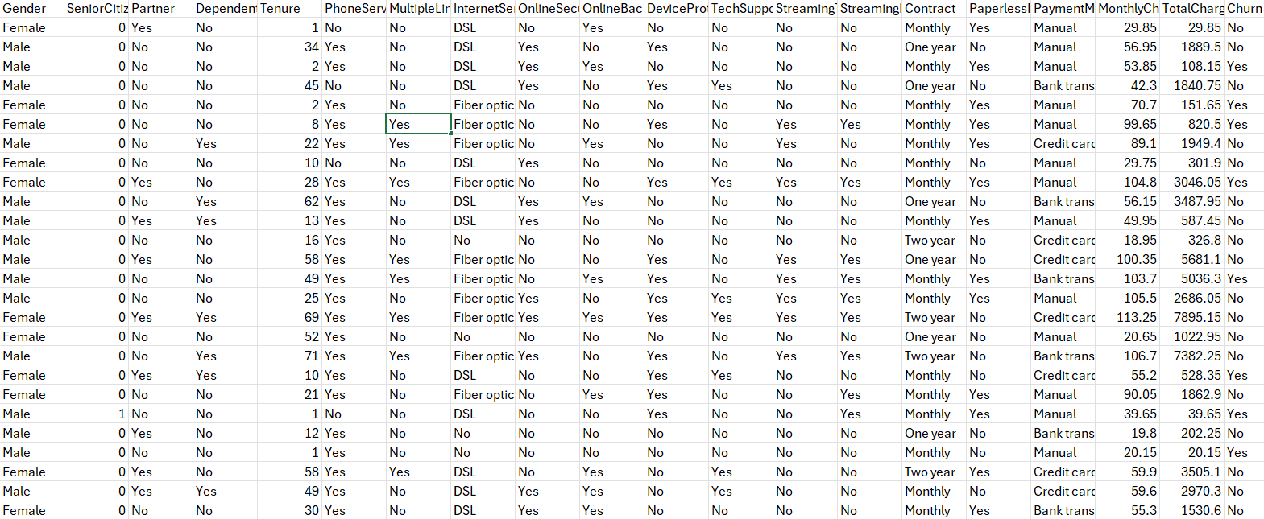
Dataset link: Here

Slide 8
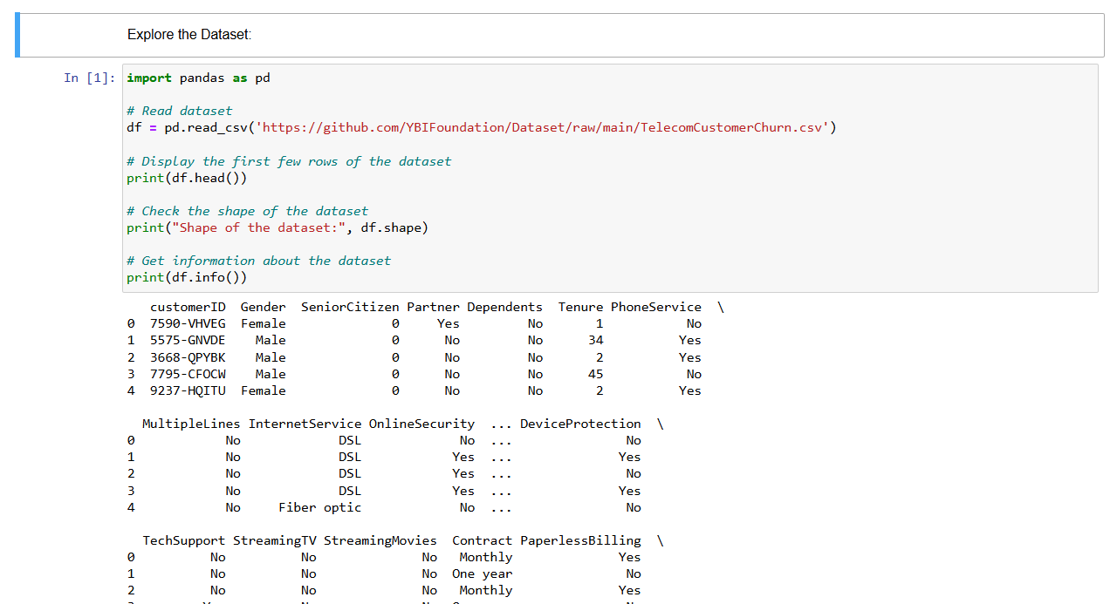
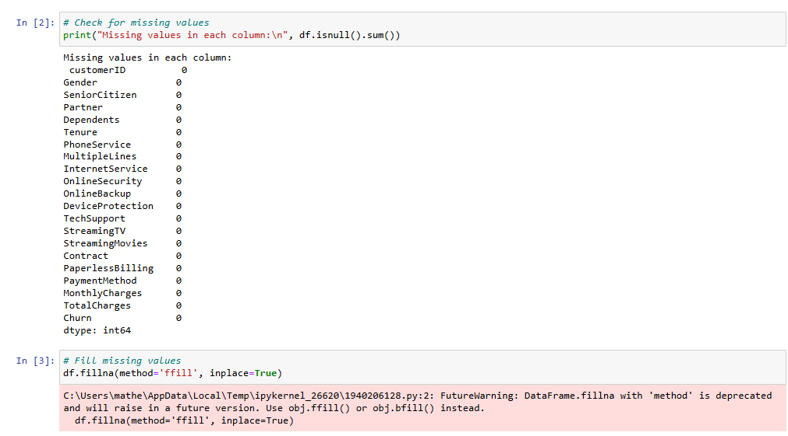

Slide 9
Exploratory Data Analysis (EDA)

Slide 10
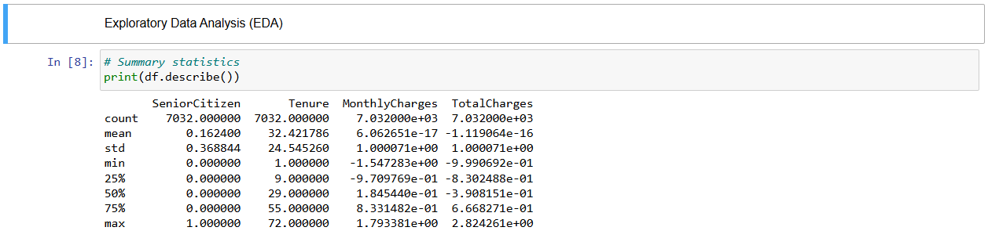

Slide 11
Correlation heatmap to identify relationships between variables. Churn distribution to understand the target variable ‘Churn’.

Slide 12
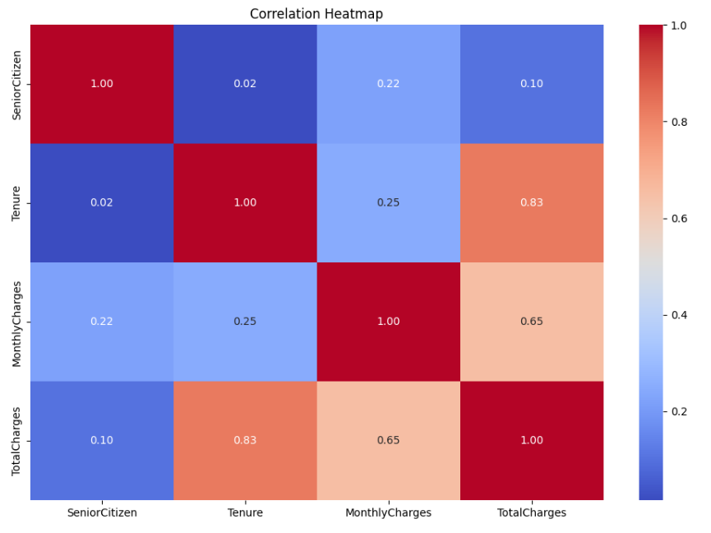

Slide 13
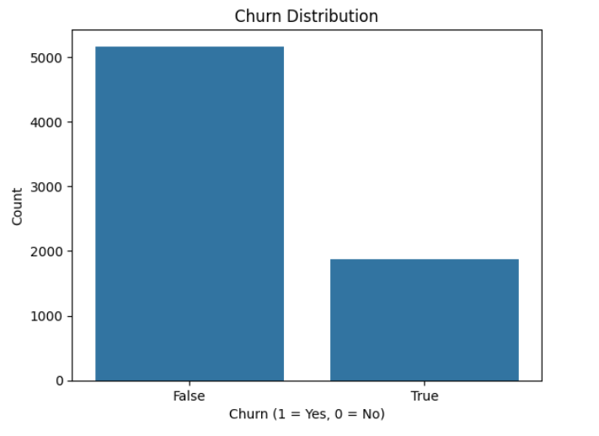

Slide 14
Key Findings: Churn Distribution: Approximately 26.5% of customers have churned.

Slide 15
MonthlyCharges and TotalCharges: Correlation Coefficient: Close to 0.65 There is a strong positive correlation between MonthlyCharges and TotalCharges. This makes sense because the total charges are accumulated over time, and higher monthly charges will naturally lead to higher total charges.

Slide 16
Tenure and TotalCharges: Correlation Coefficient: Close to 0.83 There is a very strong positive correlation between Tenure (the number of months the customer has stayed with the company) and TotalCharges. This indicates that the longer a customer stays, the higher their total charges will be, which is expected.

Slide 17
Tenure and MonthlyCharges: Correlation Coefficient: Close to 0.25 There is a weak positive correlation between Tenure and MonthlyCharges. This suggests that customers who stay longer might have slightly higher monthly charges, but the relationship is not very strong.

Slide 18

Hyperparameter Tuning

Slide 19
Methods Used: GridSearchCV and RandomizedSearchCV. Results: Tuned hyperparameters for Random Forest. Improved model performance and documented the best parameters.

Slide 20

Model Selection and Building

Slide 21

Models Chosen: Logistic Regression, Random Forest, Support Vector Classifier (SVC). Training and Validation: Split data into training and testing sets. Trained models and evaluated using accuracy, precision, recall, and F1-score. Performance Comparison: Presented evaluation metrics for each model.

Slide 22
Model Performance Comparison

Slide 23
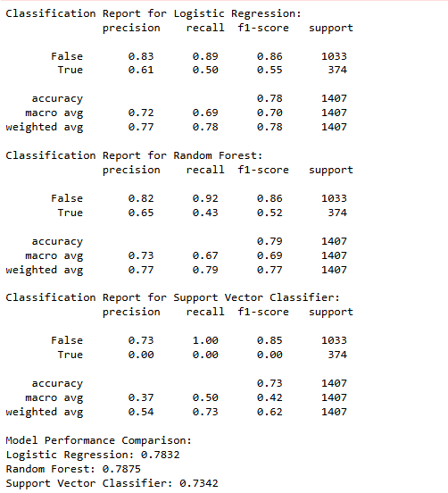

Slide 24
Logistic Regression: Accuracy: 79.03% Precision: 0.83 (Not Churn), 0.63 (Churn) Recall: 0.89 (Not Churn), 0.51 (Churn) Random Forest: Accuracy: 79.25% Precision: 0.82 (Not Churn), 0.67 (Churn) Recall: 0.92 (Not Churn), 0.44 (Churn) Support Vector Classifier: Accuracy: 73.42% Precision: 0.73 (Not Churn), 0.00 (Churn) Recall: 1.00 (Not Churn), 0.00 (Churn)

Slide 25
Hyperparameter Tuning

Slide 26
Methods Used: RandomizedSearchCV for Random Forest. Results: Best parameters: {'n_estimators': 100, 'min_samples_split': 2, 'min_samples_leaf': 1, 'max_depth': None} Improved accuracy to 79.18%.

Slide 27
Model Evaluation and Validation

Slide 28
Cross-Validation: Used cross-validation to ensure model generalizability. Test Set Evaluation: Evaluated the final model on the test set. Reported accuracy, precision, recall, and F1-score.

Slide 29
Model Deployment

Slide 30
Deployment Method: Postman: Used Postman to test and deploy the model. Flask API: Set up a REST API using Flask for real-time predictions. Steps: Step 1: Created a Flask application to serve the model. Step 2: Defined a route for predictions in the Flask app. Step 3: Used Postman to send HTTP requests to the Flask API and receive predictions.

Slide 31
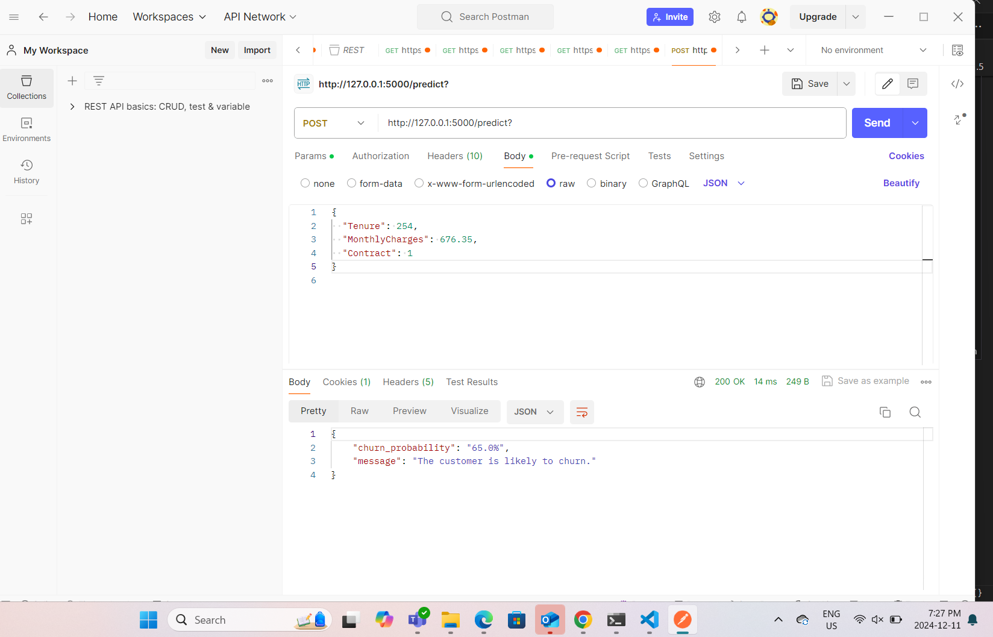

Slide 32


Conclusion
In our analysis of customer churn for a telecommunications company, we identified several key factors influencing churn rates. Our findings indicate that senior citizens, customers with month-to-month contracts, and those with fiber optic internet service are more likely to churn. Additionally, higher monthly charges are associated with increased churn rates. We developed and evaluated multiple machine learning models, with the Random Forest model showing the best performance. Based on our insights, we recommend implementing targeted retention strategies for at-risk customers, offering incentives for long-term contracts, and addressing issues with fiber optic service to improve customer retention. Despite facing challenges in data cleaning, deployment, and time management, our team successfully completed the project, providing valuable insights and actionable recommendations to reduce customer churn.

Slide 33




Thank you Video link
youtube link

